Slide 1
FPGA Acceleration for 3D Low-Dose CT
Ming Jiang
Peking University
ming-Jiang@pku.edu.cn
MS 1 : Applied Mathematics in Tomography
Conference on Modern Challenges in Imaging
2019.08.08
Presentation based on materials/comments from Jason Cong, Yong Cui, William Hsu, Alfred Louis, Xiuhong Li, Yun Liang, Guojie Luo, Peter Maass, Thomas Page, Linjun Qiao, Frank Natterer, Thomas Schuster, Wentai Zhang.

Slide 2
Outline
Background & Motivation
  Energy-efficient computing with FPGA
Asynchronous parallel iterative algorithms
  Communication model
FPGA implementation
  Techniques for implementation
Summary

Slide 3
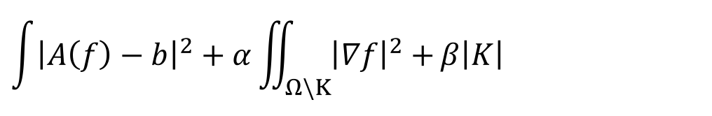
Mumford-Shah functional as a regularization for image reconstruction
$$\int{{\left|A\left(f\right)−b\right|}^{2}}+α\iint_{Ω\backslash K}{{\left|∇f\right|}^{2}+}β\left|K\right|$$
Avoid computing derivatives cross edges
Simultaneous reconstruction of image and its segmentation
NP-hard when A is not the identity
Geman and Geman [1984]
Mumford and Shah [1989]
Ambrosio [1989]
De Giorgi, Carriero, and Leaci [1989]
Vese, Chan [2000]
Chan, Esedoglu and Nikolova [2004]
Cai, Chan, Zeng [2013]
Chan, Yang, Zeng [2014]
Rondi and Santosa [2001]
Rondi [2007]
Alexeev, and Ward [2010]
Fornasier, March, Solombrino [2011]
Scherzer [2011, 2014]
Ramlau, Ring [2010]
Klann, Ramlau [2013]
………
Jiang, Maass, Page [2014]
Storath, Weinmann; Frikel, Unser [2015]
Hohm, Storath, Weinmann [2015]
Carriero, Leaci, Tomarelli [2015]
An incomplete list…..

Slide 4
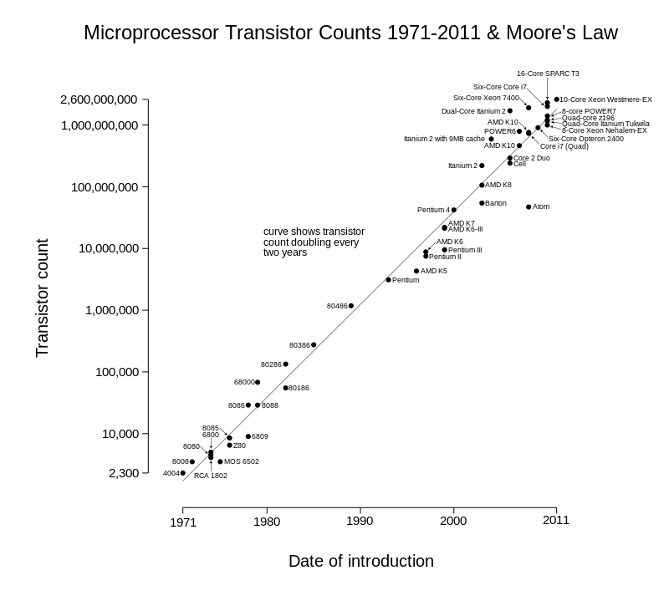
Dark silicon
https://en.wikipedia.org/wiki/Transistor_count

Slide 5



Customization and Specialization
sun’s surface
1000
Power consumption doubled every 4 years
rocket nozzle
nuclear reactor
Parallelization
100
Pentium® 4
Customization
Watts/cm²
Pentium III®
hot plate
Pentium II®
Adapt the architecture to
application domain
10
Pentium Pro®
Pentium®
i386
i486
1
1.5µ
1.0µ
0.7µ
0.5µ
0.35µ
0.25µ
0.18µ
0.13µ
0.10µ
0.07µ
Based on Fred Pollack (Intel) and Michael Taylor (UCSD)
Curtesy of Prof. Jason Cong
Notes:
Muhuan: figure from Michael Taylor, UCSD; data is from Intel

Slide 6
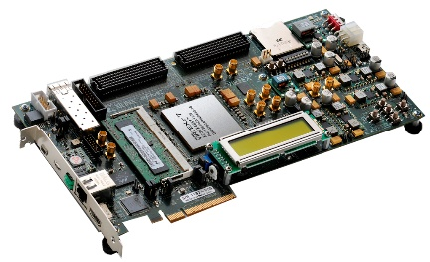
Energy-efficient computing with FPGA
FPGA is another hardware accelerating approach
  Multi-core-CPU clusters, GPU and DSP,.
FPGA (field-programmable gate array)
  function is defined by a user's program
  reconfigurable for computing
  Limited onboard memory vs others
Xilinx Virtex-7 board VC707 at 100MHz
  485K logic gates, 4.5MB onboard memory
  Transistor count: 6,800,000,000
  4.5W (~consumer LED lamp)
How to make the best use of it?
https://en.wikipedia.org/wiki/LED_lamp

Slide 7
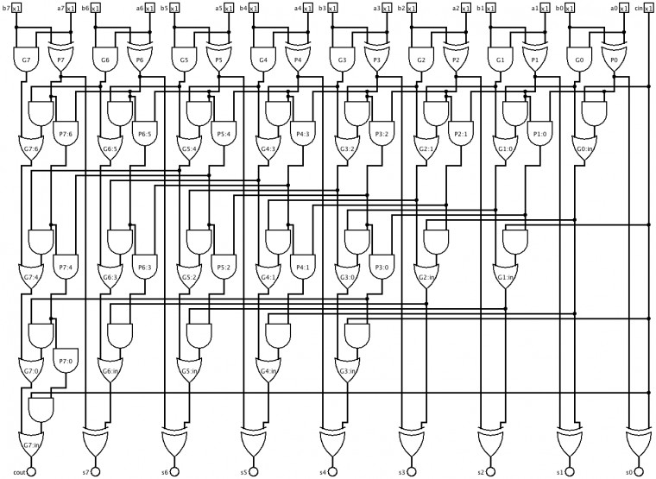
Logical circuits of an 8-bit Adder
Gate-Level Diagram of an 8-bit Kogge-Stone Parallel Prefix Adder
http://venividiwiki.ee.virginia.edu/.......

Slide 8
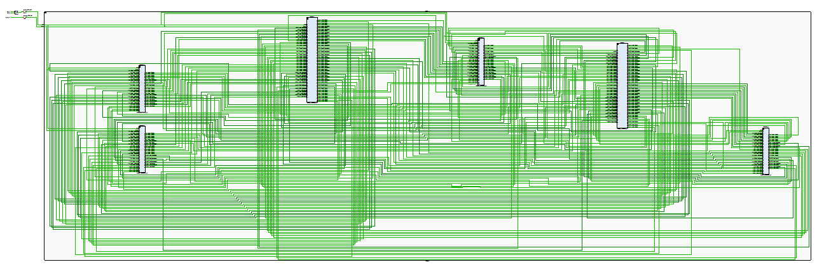
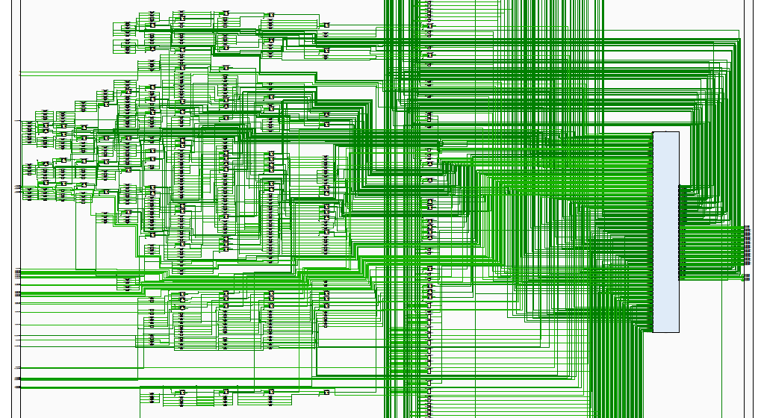
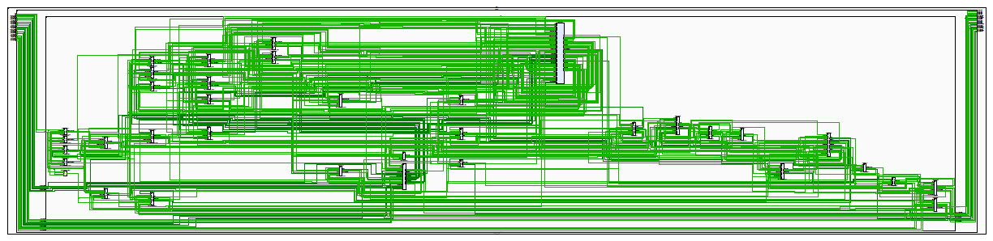
FPGA Implementation of Mumford-Shah Imaging Algorithm
XCT Reconstruction with Mumford-Shah: 200K LUT (logic look-up tables)

Slide 9
High-level Synthesis C->FPGA
Energy-efficient accelerator-rich architecture
Optimization under the performance, power, and cost constraints
Extensive use of accelerators (algorithmic blocks)
Limited onboard memory with full control including precision
  Extendable
VivadoHLS of Xilinx
  https://www.xilinx.com/products/design-tools/vivado.html
How to design algorithms for FPGA
  to enable the advantages of FPGA
Cong et al, High-Level Synthesis for FPGAs: From Prototyping to Deployment, 2011.

Slide 10
Outline
Background & Motivation
  Energy-efficient computing with FPGA
Asynchronous parallel iterative algorithms
  Communication model
FPGA implementation
  Techniques for implementation
Summary

Slide 11
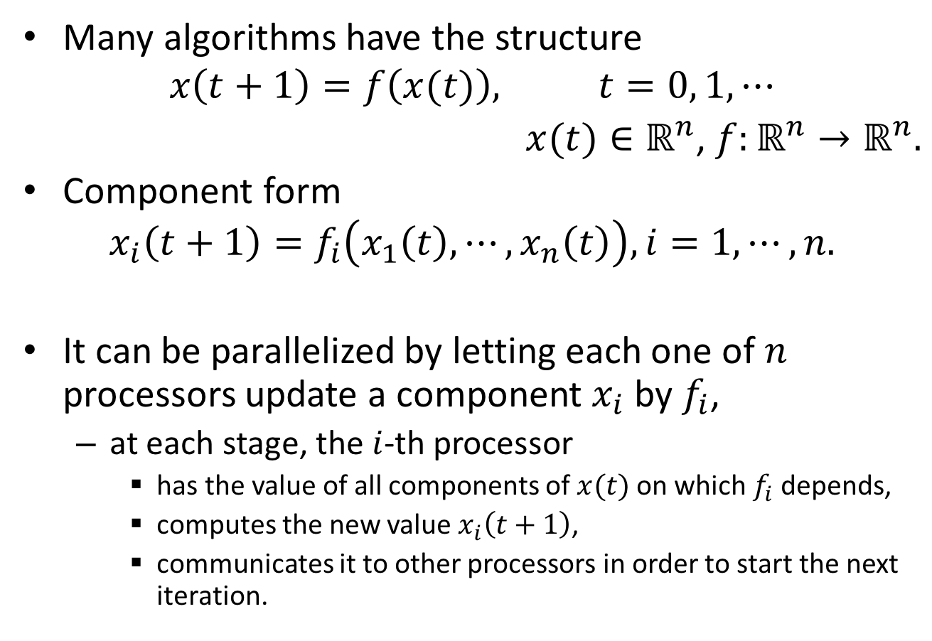
Iterative methods
Many algorithms have the structure
$$x\left(t+1\right)=f\left(x(t)\right), t=0, 1, ⋯$$
$x(t)∈ℝ^{n}$, $f:ℝ^{n}→ℝ^{n}.$
Component form
$$x_{i}\left(t+1\right)=f_{i}\left(x_{1}\left(t\right), ⋯,x_{n}\left(t\right)\right), i=1, ⋯, n.$$
It can be parallelized by letting each one of $n$ processors update a component $x_{i}$ by $f_{i}$,
  at each stage, the $i$-th processor
    has the value of all components of $x(t)$ on which $f_{i}$ depends,
    computes the new value $x_{i}\left(t+1\right)$,
    communicates it to other processors in order to start the next iteration.
Bertsekas and Tsitsiklis, Parallel and distributed computation : numerical methods. 1989.

Slide 12
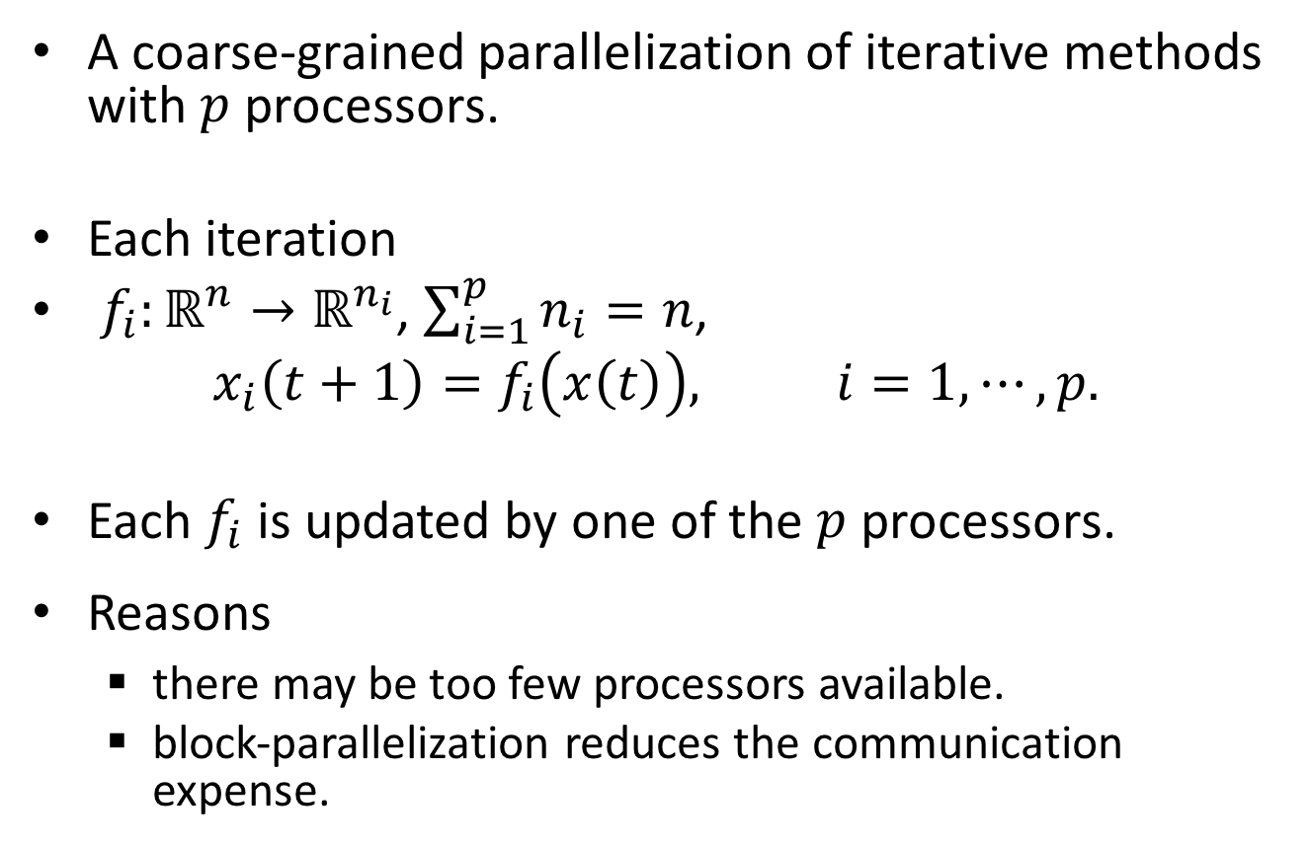
Block iterative methods
A coarse-grained parallelization of iterative methods with $p$ processors.
Each iteration
$f_{i}:ℝ^{n}→ℝ^{n_{i}}$, $\sum_{i=1}^{p}{n_{i}}=n$,
$$x_{i}\left(t+1\right)=f_{i}\left(x\left(t\right)\right), i=1, ⋯, p.$$
Each $f_{i}$ is updated by one of the $p$ processors.
Reasons
  there may be too few processors available.
  block-parallelization reduces the communication expense.
Bertsekas and Tsitsiklis, Parallel and distributed computation : numerical methods. 1989.

Slide 13
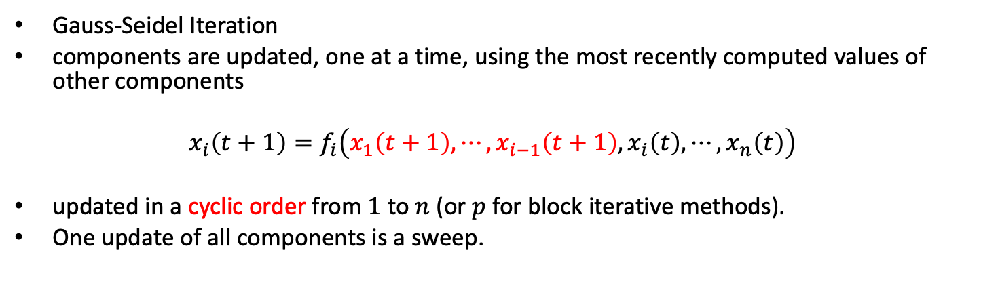
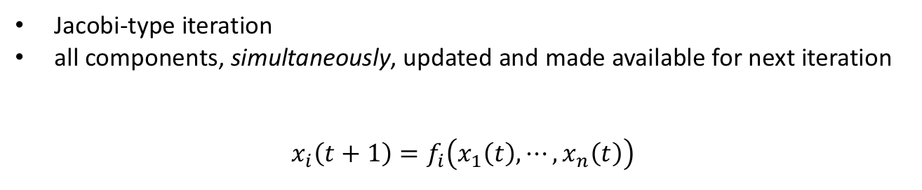
Jacobi and Gauss-Seidel Iterations
Jacobi-type iteration
all components, simultaneously, updated and made available for next iteration
$$x_{i}\left(t+1\right)=f_{i}\left(x_{1}\left(t\right), ⋯,x_{n}\left(t\right)\right)$$
Gauss-Seidel Iteration
components are updated, one at a time, using the most recently computed values of other components
$$x_{i}\left(t+1\right)=f_{i}\left(x_{1}\left(t+1\right), ⋯,x_{i−1}\left(t+1\right),x_{i}\left(t\right),⋯,x_{n}\left(t\right)\right)$$
updated in a cyclic order from $1$ to $n$ (or $p$ for block iterative methods).
One update of all components is a sweep.
Bertsekas and Tsitsiklis, Parallel and distributed computation : numerical methods. 1989.

Slide 14
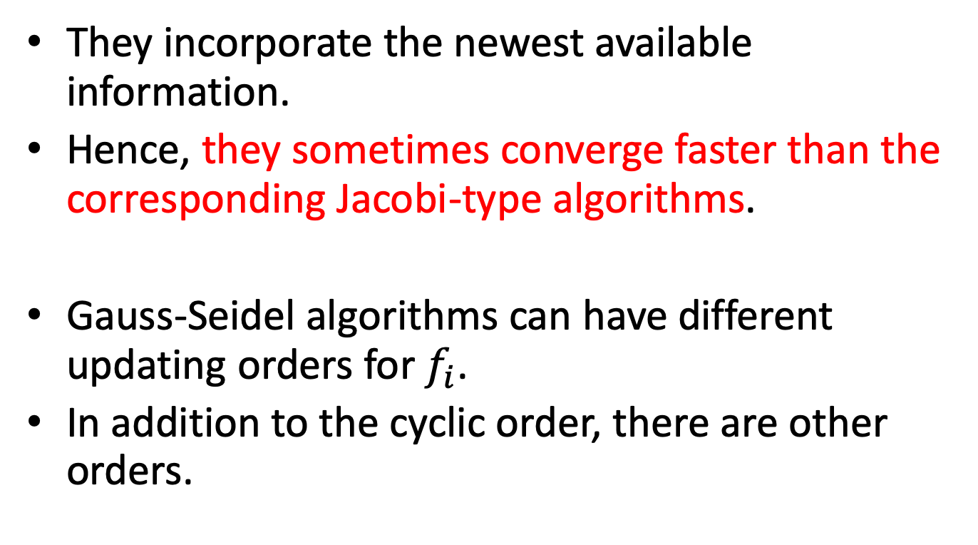
Gauss-Seidel Iteration
They incorporate the newest available information.
Hence, they sometimes converge faster than the corresponding Jacobi-type algorithms.
Gauss-Seidel algorithms can have different updating orders for $f_{i}$.
In addition to the cyclic order, there are other orders.
Bertsekas and Tsitsiklis, Parallel and distributed computation : numerical methods. 1989.
Censor and Zenios, Parallel Optimization: Theory, Algorithms and Applications, 1997.

Slide 15
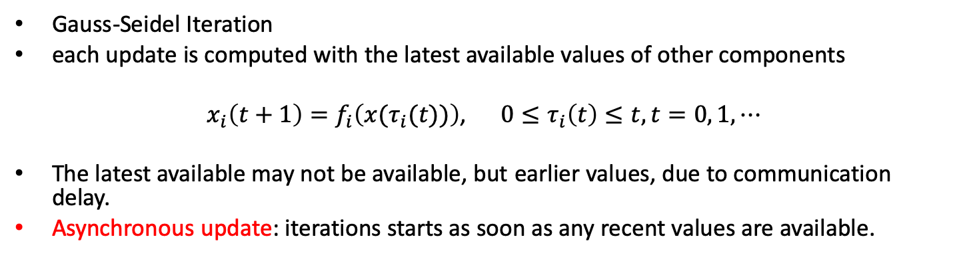
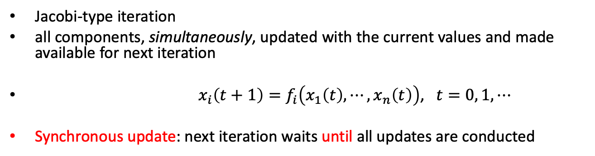
Parallelization of Jacobi and Gauss-Seidel Iterations
Jacobi-type iteration
all components, simultaneously, updated with the current values and made available for next iteration
$x_{i}\left(t+1\right)=f_{i}\left(x_{1}\left(t\right), ⋯,x_{n}\left(t\right)\right)$, $t=0, 1, ⋯$
Synchronous update: next iteration waits until all updates are conducted
Gauss-Seidel Iteration
each update is computed with the latest available values of other components
$x_{i}\left(t+1\right)=f_{i}\left(x(τ_{i}(t))\right)$, $0≤τ_{i}\left(t\right)≤t,t=0, 1, ⋯$
The latest available may not be available, but earlier values, due to communication delay.
Asynchronous update: iterations starts as soon as any recent values are available.
Bertsekas and Tsitsiklis, Parallel and distributed computation : numerical methods. 1989.
Avron, et al, Revisiting asynchronous linear solvers: provable convergence rate through randomization, Journal of ACM, 2015.

Slide 16
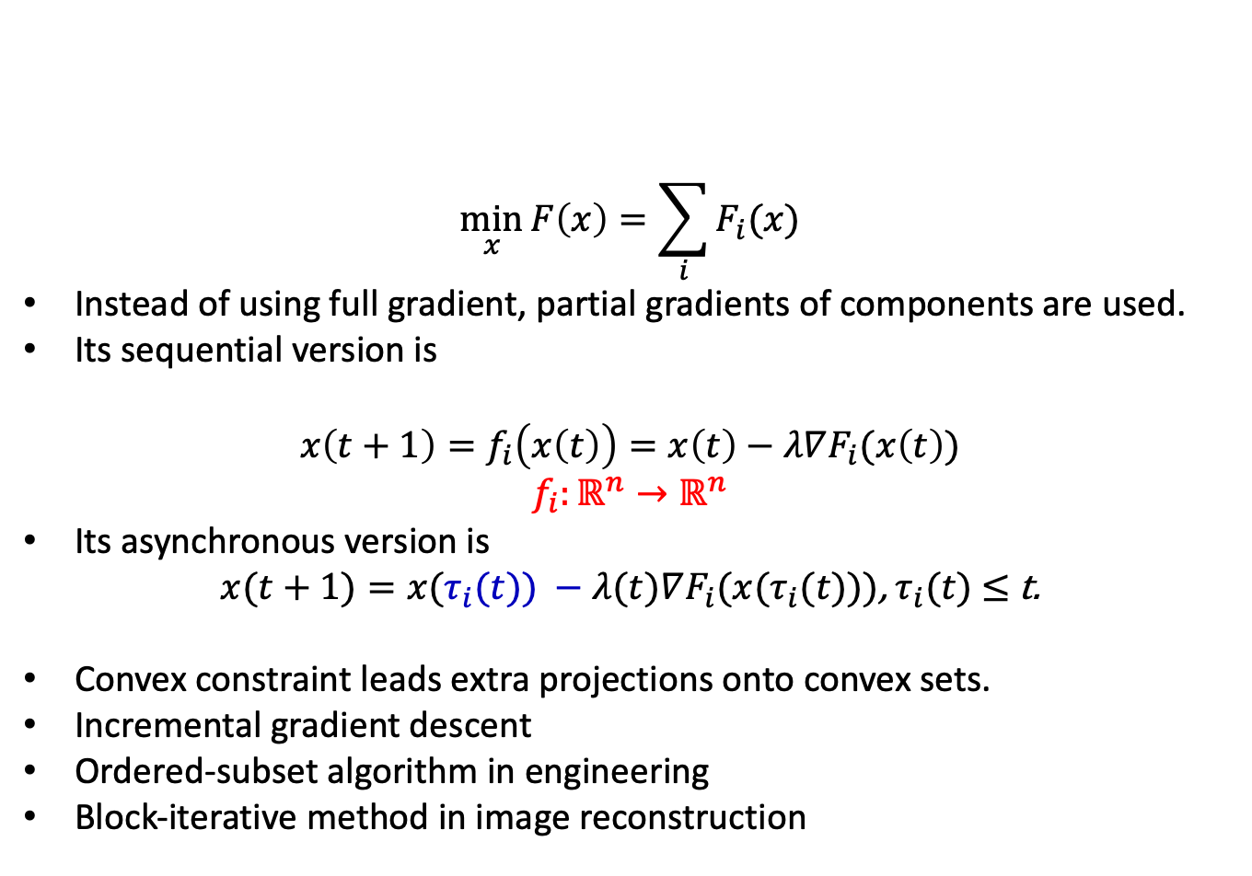
Stochastic gradient descent method
$$\min_{x}{F\left(x\right)=\sum_{i}{F_{i}(x)}}$$
Instead of using full gradient, partial gradients of components are used.
Its sequential version is
$$x\left(t+1\right)=f_{i}\left(x\left(t\right)\right)=x\left(t\right)−λ∇F_{i}(x\left(t\right))$$
$$f_{i}:ℝ^{n}→ℝ^{n}$$
Its asynchronous version is
$x(t+1)=x(τ_{i}(t)) −λ(t)∇F_{i}(x(τ_{i}(t)))$, $τ_{i}(t)$ $≤$ t.
Convex constraint leads extra projections onto convex sets.
Incremental gradient descent
Ordered-subset algorithm in engineering
Block-iterative method in image reconstruction
Kiwiel, Convergence of approximate and incremental subgradient methods for convex optimization, SIAM J. Optim., 2004.
Liu, et al, An Asynchronous Parallel Stochastic Coordinate Descent Algorithm, J. of Machine Learning Research, 2015.
Hannah and Yin, More Iterations per Second, Same Quality – why Asynchronous Algorithms may Drastically Outperform Traditional Ones, 2017. Preprint.

Slide 17
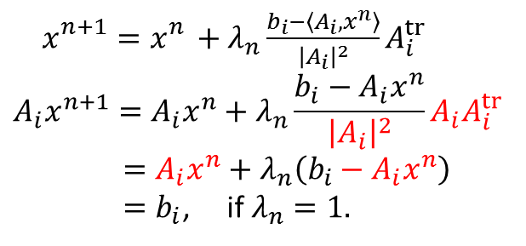
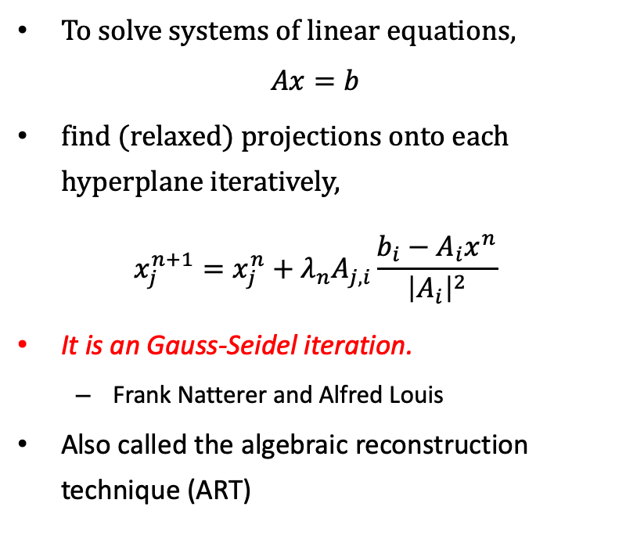
Kaczmarz Algorithm
To solve systems of linear equations,
$$Ax=b$$
find (relaxed) projections onto each hyperplane iteratively,
$$x_{j}^{n+1}=x_{j}^{n}+λ_{n}A_{j,i}\frac{b_{i}−A_{i}x^{n}}{{\left|A_{i}\right|}^{2}}$$
It is an Gauss-Seidel iteration.
  Frank Natterer and Alfred Louis
Also called the algebraic reconstruction technique (ART)
$x_{}^{n+1}=x_{}^{n}+λ_{n}\frac{b_{i}−\left\langle A_{i},x^{n}\right\rangle }{{\left|A_{i}\right|}^{2}}A_{i}^{tr}$
$$A_{i}x^{n+1}=A_{i}x^{n}+λ_{n}\frac{b_{i}−A_{i}x^{n}}{{\left|A_{i}\right|}^{2}}A_{i}A_{i}^{tr}$$
$=A_{i}x^{n}+λ_{n}\left(b_{i}−A_{i}x^{n}\right)$
$=b_{i}$, if $λ_{n}=1.$

Slide 18
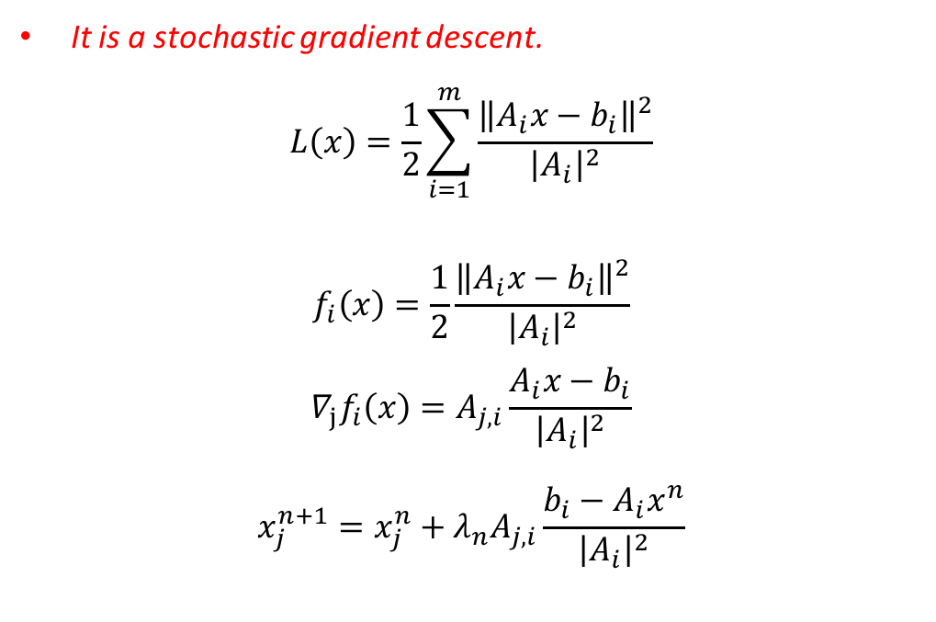
Kaczmarz Algorithm
It is a stochastic gradient descent.
$$L\left(x\right)=\frac{1}{2}\sum_{i=1}^{m}{\frac{{\left\|A_{i}x−b_{i}\right\|}^{2}}{{\left|A_{i}\right|}^{2}}}$$
$$f_{i}\left(x\right)=\frac{1}{2}\frac{{\left\|A_{i}x−b_{i}\right\|}^{2}}{{\left|A_{i}\right|}^{2}}$$
$${∇_{j}f}_{i}\left(x\right)=A_{j,i}\frac{{A_{i}x−b}_{i}}{{\left|A_{i}\right|}^{2}}$$
$$x_{j}^{n+1}=x_{j}^{n}+λ_{n}A_{j,i}\frac{b_{i}−A_{i}x^{n}}{{\left|A_{i}\right|}^{2}}$$
Its sequential version converges under the diminishing condition.
Its asynchronous iteration is not well covered in literature.

Slide 19
Asynchronous Parallel Kaczmarz (I)
Parallel Gauss-Seidel Iteration
X1
X1
ART1
X
Schedule/
Partition step
X
X2
ART2
X2
ART3
X3
X3

Slide 20
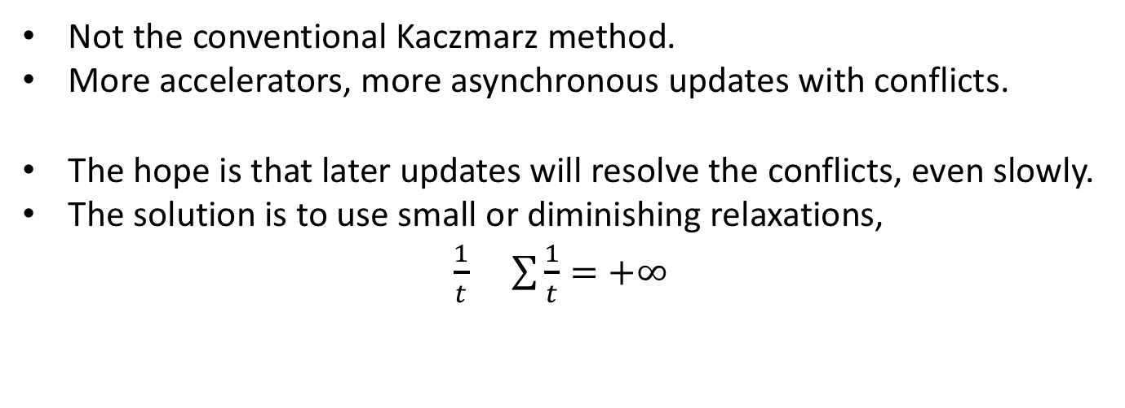
Asynchronous Parallel Kaczmarz (II)
X1
X1 | A, C | t1 | A1, C1
X2 | A, B | t2 | A2, B2
X3 | C, B | t3 | C3, B3
A
B
X2
X3
In the next update of X1, will C1 or C3 be used?
C
Not the conventional Kaczmarz method.
More accelerators, more asynchronous updates with conflicts.
The hope is that later updates will resolve the conflicts, even slowly.
The solution is to use small or diminishing relaxations,
$\frac{1}{t}$ $\sum{\frac{1}{t}}=+∞$

Slide 21
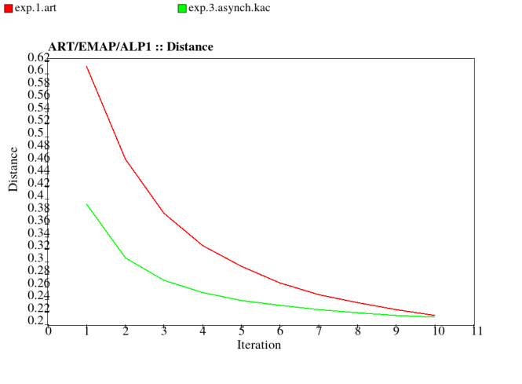
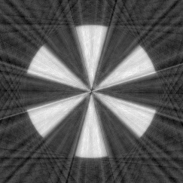
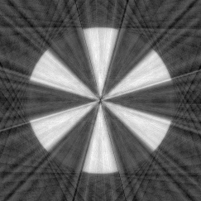
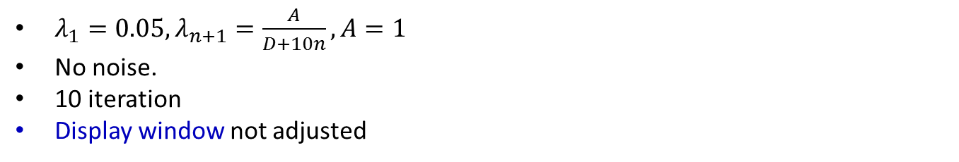
Experiments – Kaczmarz method(I)
${λ_{1}=0.05, λ}_{n+1}=\frac{A}{D+10n}, A=1$
No noise.
10 iteration
Display window not adjusted
Kaczmarz
Asynchronous parallel Kaczmarz with 3 threads

Slide 22
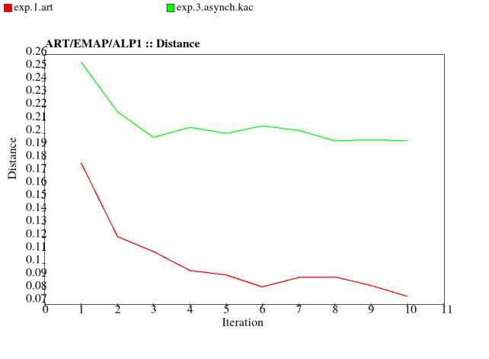


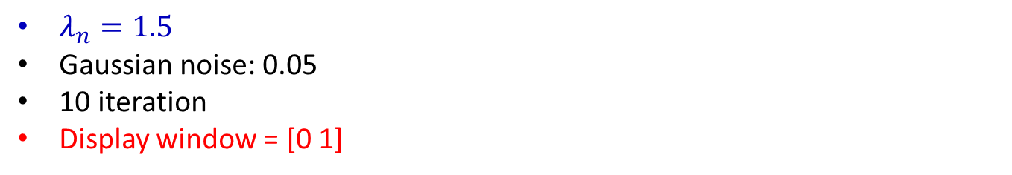
Experiments – Kaczmarz method(IV)
$λ_{n}=1.5$
Gaussian noise: 0.05
10 iteration
Display window = [0 1]
Kaczmarz
Asynchronous parallel Kaczmarz with 3 threads

Slide 23
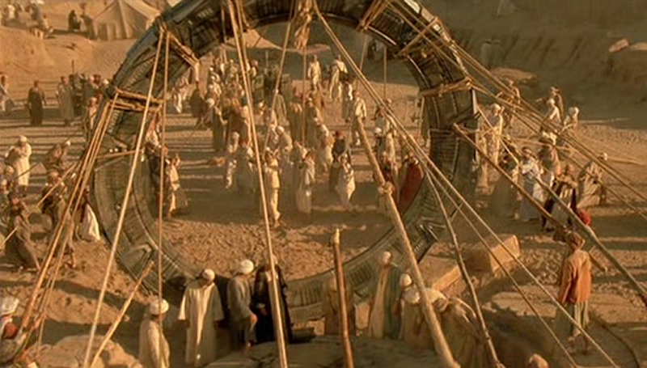

Heuristics for Asynchronous Parallelism
Heuristics
  欲速则不达：
  Haste does not bring success.
  Haste makes waste.
  Eile mit Weile. (from Google translate)
  Immer mit der Ruhe. (from Thomas Schuster)
Examples
  Lifting heavy object by a group people
  Painting a big picture by a group of painters
  My lessons
    Do not use full strength, but do it slowly and slowly.
    No waiting does not mean to be hash.
Expected performance
  reconstruction images in early iterations even with small or diminishing relaxation, as ordered-subset methods do.
Egyptian laborers lift the Stargate out of the ground in 1928
http://stargate.wikia.com/wiki/Tau'ri

Slide 24
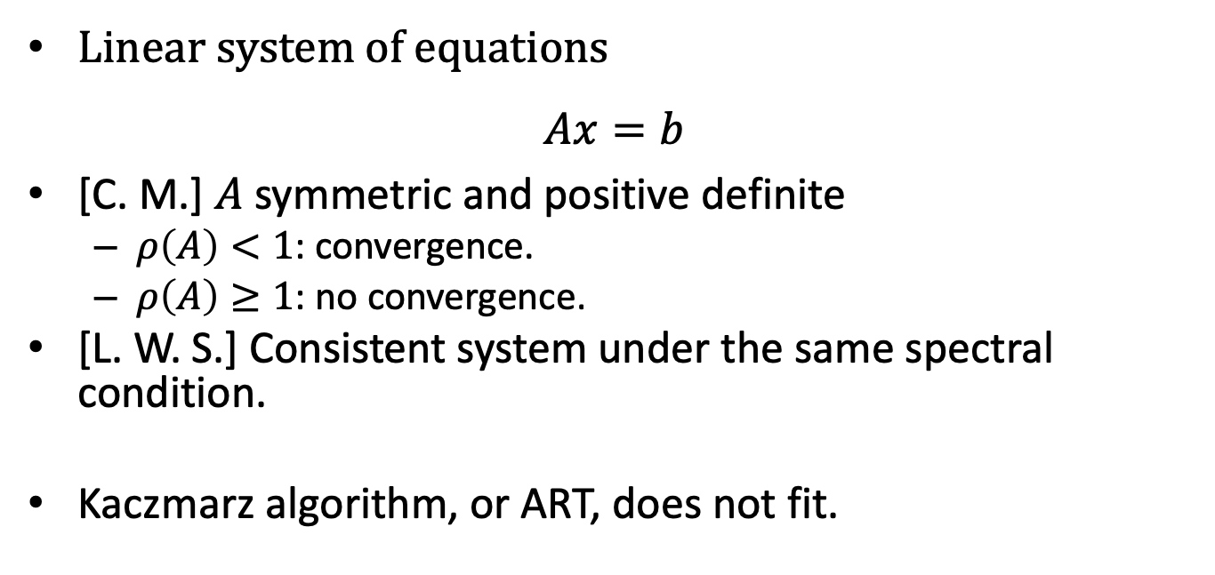
Convergence results (I)
Linear system of equations
$$Ax=b$$
[C. M.] $A$ symmetric and positive definite
  $ρ\left(A\right)<1$: convergence.
  $ρ\left(A\right)≥1$: no convergence.
[L. W. S.] Consistent system under the same spectral condition.
Kaczmarz algorithm, or ART, does not fit.
Rosenfeld, A case study in programming for parallel-processors, Communications of the ACM, 1969. (research report in 1967).
Chazan and Miranker, Chaotic relaxation, Linear Algebra and its Applications, 1969.
Liu, Wright, and Sridhar, An Asynchronous Parallel Randomized Kaczmarz Algorithm, 2014. Preprint.

Slide 25
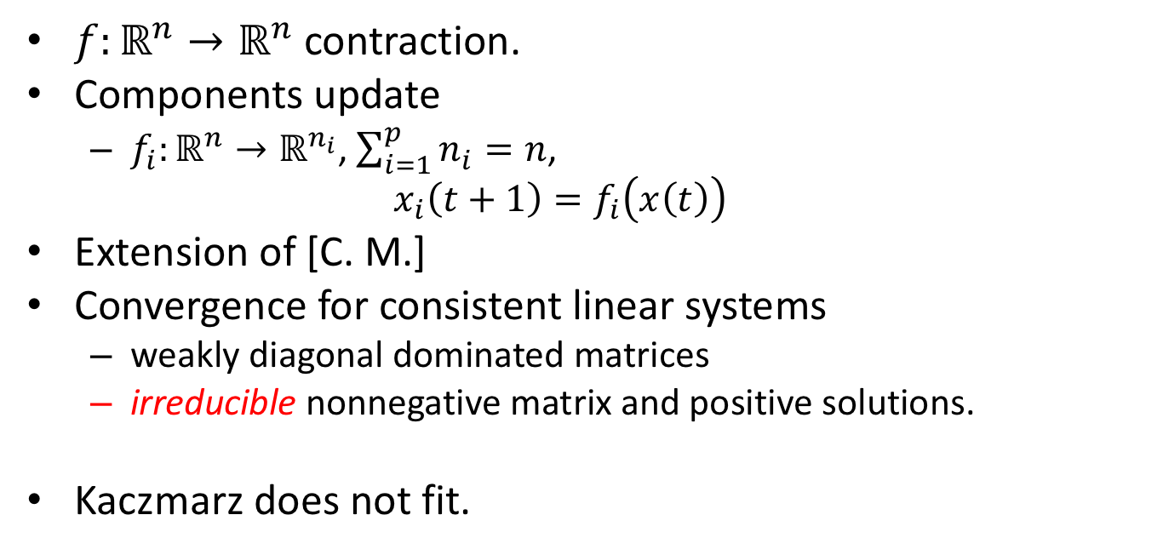
Convergence results (II)
$f:ℝ^{n}→ℝ^{n}$ contraction.
Components update
  $f_{i}:ℝ^{n}→ℝ^{n_{i}}$, $\sum_{i=1}^{p}{n_{i}}=n$,
  $$x_{i}\left(t+1\right)=f_{i}\left(x\left(t\right)\right)$$
Extension of [C. M.]
Convergence for consistent linear systems
  weakly diagonal dominated matrices
  irreducible nonnegative matrix and positive solutions.
Kaczmarz does not fit.
Bertsekas and Tsitsiklis, Parallel and distributed computation : numerical methods. 1989.
Frommer, On asynchronous iterations, Journal of Computational and Applied Mathematics, 2000.
Frommer and Spiteri, On linear asynchronous iterations when the spectral radius of the modulus matrix is one. Topics in numerical analysis, 2001.

Slide 26
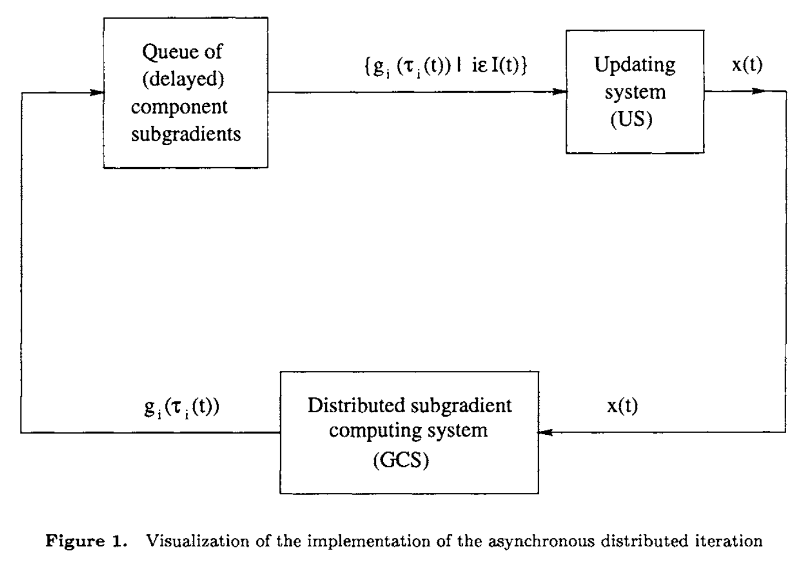

One convergence result
Asynchronous version
$x(t+1)=x(t) −λ(t)∇f_{i}(x(τ_{i}(t))$.
Convexity
Diminishing relaxations
Bounded delay
  $λ\sim \frac{1}{n^{q}}, q≤1.$
  $t≤τ_{i}\left(t\right)+D$.
Nedić, Bertsekas, Borkar, Distributed asynchronous incremental subgradient methods, 2001.

Slide 27
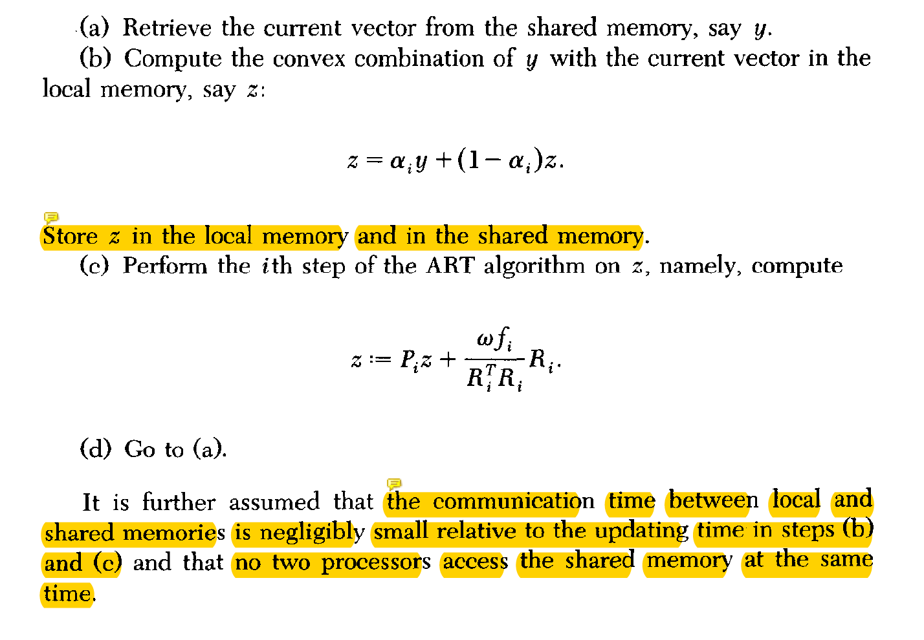
Diversified convergence results
Different asynchronous models
  Master or without master?
  Update all or partial solution vector?
Different combinations of object functions
  Fidelity + regularization
Different communication assumptions
  Mostly ambiguous
  Not well modelled w.r.t computing architecture.
Different relaxations
  Fixed or diminishing?
Deterministic or probabilistic convergence.
Low precision implementation
  Big data applications typically requires low accuracy
Liu, Wright, et al, An Asynchronous Parallel Stochastic Coordinate Descent Algorithm, J. of Machine Learning Research, 2015.
Hannah and Yin, More Iterations per Second, Same Quality – why Asynchronous Algorithms may Drastically Outperform Traditional Ones, 2017. Preprint.
De Sa, et al, Understanding and Optimizing Asynchronous Low-Precision Stochastic Gradient Descent, ISCA'17, 2017.

Slide 28
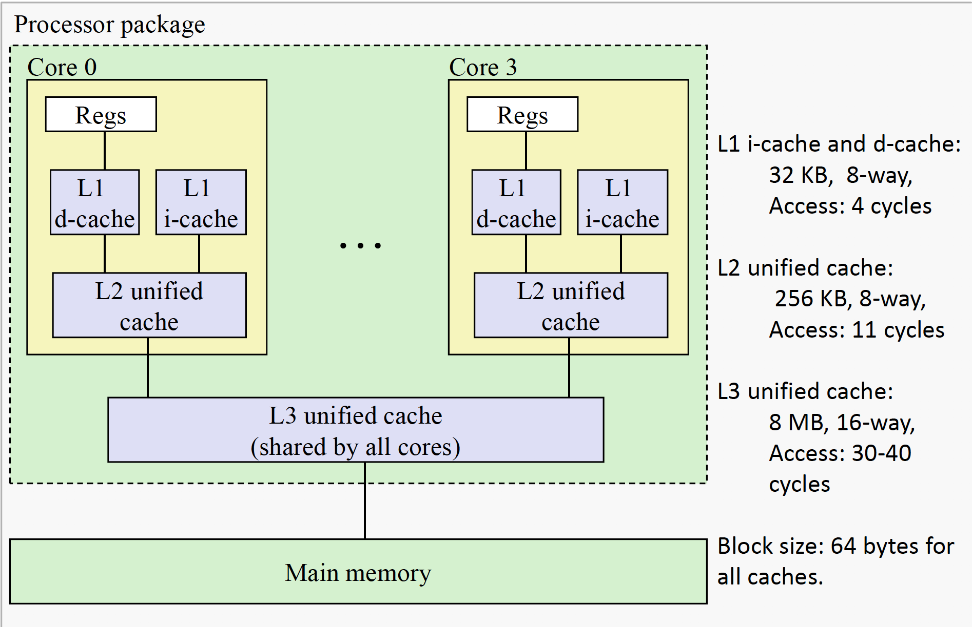
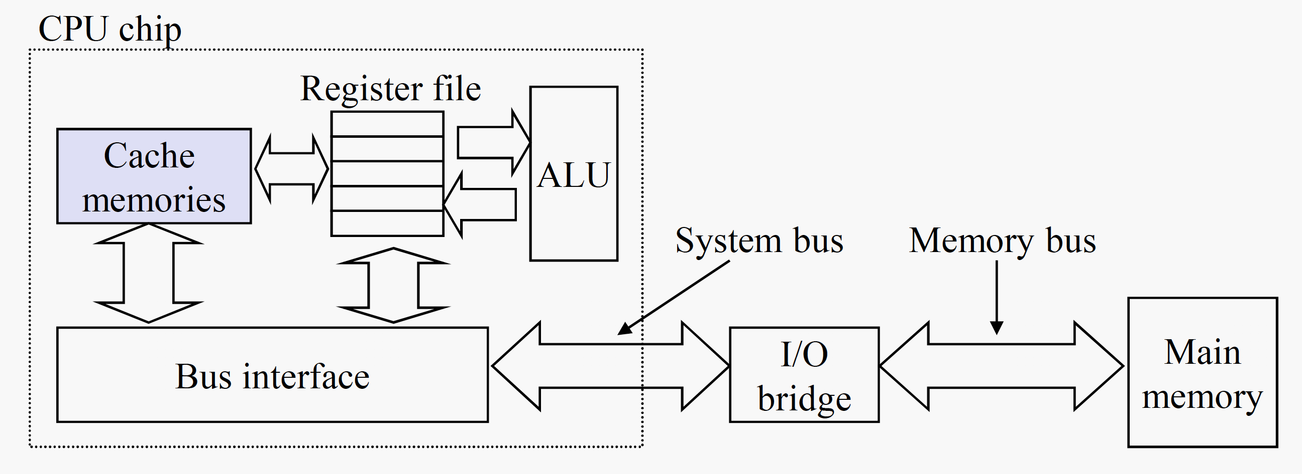
CPU Operation vs Memory Access
x86 CPU fast for arithmetic operations
  ~1 cycle
X86 bus architecture slow for memory access
  ~10 cycle
Memory Wall
Intel® 64 and IA-32 Architectures
Optimization Reference Manual, 2016.
Writing Cache Friendly Code…
Memory protection from CPU instruction, to operating systems. …
http://courses.cs.vt.edu/cs2506/Fall2014/Notes/L16.CachePoliciesAndPerformance.pdf

Slide 29
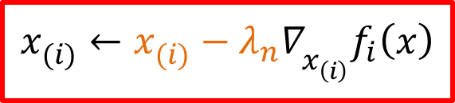
Asynchronous updates in data flow
$$x_{(i)}^{}←x_{(i)}^{}−λ_{n}∇_{x_{\left(i\right)}^{}}f_{i}\left(x\right)$$
CPU
Complicated multiple asynchronous delays at arrow ends
System Cache
Main Memory
FPGA/GPU
Registers
On-board Memory
$x(t+1)=x(τ_{i}(t)) −λ(t)∇f_{i}(x(τ_{i}(t)))$, $τ_{i}(t)$ $≤$ t.

Slide 30
Outline
Background & Motivation
  Energy-efficient computing with FPGA
Asynchronous parallel iterative algorithms
  Communication model
FPGA implementation
  Techniques for implementation
Summary

Slide 31
High-level Synthesis C->FPGA
Energy-efficient accelerator-rich architecture
Can be optimized under the performance, power, and cost constraints
Extensive use of accelerators (algorithmic blocks)
Limited onboard memory vs others
  Extendable
VivadoHLS of Xilinx
  https://www.xilinx.com/products/design-tools/vivado.html
How to design algorithms for FPGA?
  Asynchronous iterative parallel algorithms

Slide 32

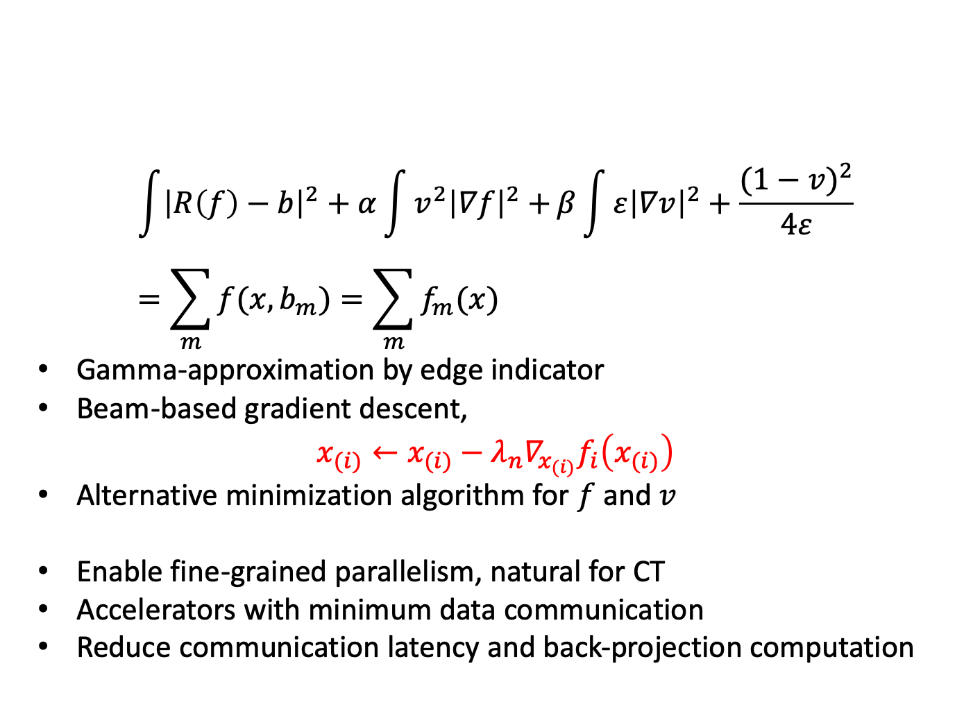
Beam-based SGD for Mumford-shah Regularization
$$\int{{\left|R\left(f\right)−b\right|}^{2}}+α\int{{v^{2}\left|∇f\right|}^{2}+}β\int{{ε\left|∇v\right|}^{2}+\frac{{(1−v)}^{2}}{4ε}}=\sum_{m}{f(x,b_{m})}=\sum_{m}{f_{m}(x)}$$
Gamma-approximation by edge indicator
Beam-based gradient descent,
$x_{(i)}←x_{(i)}−λ_{n}∇_{x_{(i)}}f_{i}\left(x_{(i)}\right)$
Alternative minimization algorithm for $f$ and $v$
Enable fine-grained parallelism, natural for CT
Accelerators with minimum data communication
Reduce communication latency and back-projection computation
FPGA Acceleration for 3D Low-Dose Tomographic Reconstruction, submitted to IEEE Transactions on Parallel and Distributed Systems, 2019.
Notes:
FPGA(4.8W)/CPU(95W):

Slide 33
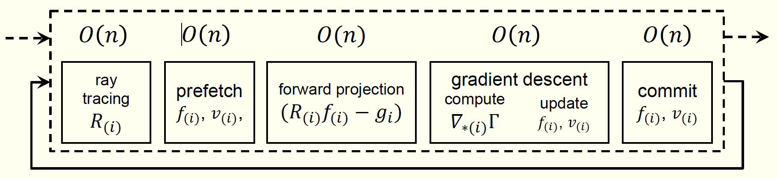
Implementation Techniques (I)
Pipeline for streaming dataflow
Achieve Load balance in the hardware pipeline.

Slide 34
Tile-based memory optimization
Frequent large sized I/O of image and projection data in 3D.
  Memory intensive.
Tile the image and projection data
  Prefetching and buffering strategy.
  Mathematical problem has not formulated.
Achieve a high data reuse rate
Save the memory bandwidth
Increase performance
Linjun Qiao, Poster at this workshop.

Slide 35
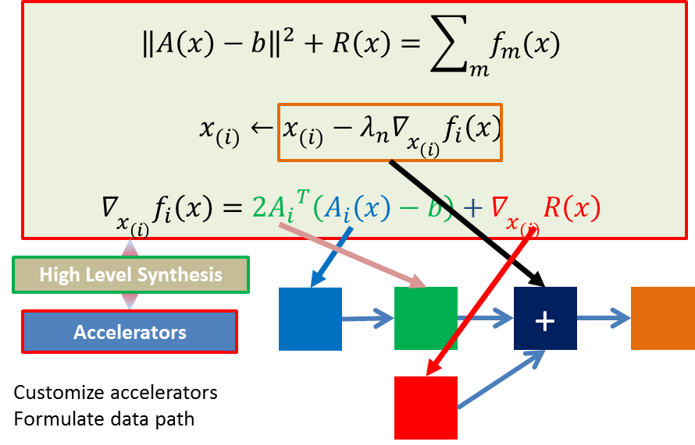
FPGA for XCT with Mumford-Shah

Slide 36
Low-dose CT Experment
CT ACR 464 phantom on the
SOMATOM Definition AS at UCLA.
Voltage: 120KV
Current: 215, 150, 100, or 50mA.

Slide 37
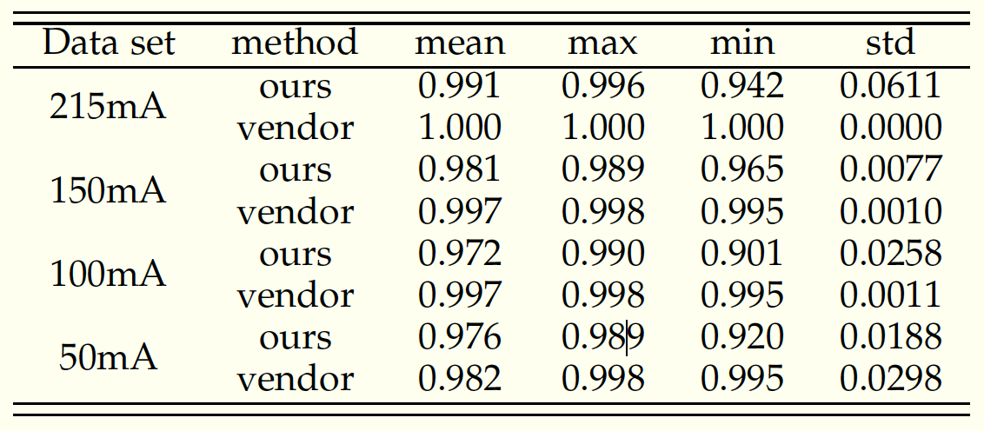
Results (SSIM)
8.5 minutes to reconstruct a typical 3D lung image with a quality comparable with the vendor’s result.

Slide 38
Outline
Background & Motivation
  Energy-efficient computing with FPGA
Asynchronous parallel iterative algorithms
  Communication model
FPGA implementation
  Techniques for implementation
Summary

Slide 39
Summary
Mumford-Shah regularization for XCT
  FPGA implementation with a quality comparable with the vendor’s result.
Asynchronous parallel computation is necessary for architectures with rich computing units
  multi-core CPU/GPU
  accelerators rich FPGA
  multi-node supercomputer
Algorithms with communication model
  Memory access/communication expense should not be ignored

Slide 40
Thank you for your attention.
Supported by
  National Science Foundation of China (61520106004).
  National Basic Research and Development Program of China (973 Program) (2015CB351803).

