Slide 1
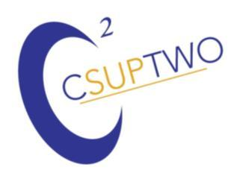
Achieving and Relaxing The Assumptions Posed by Cormack
Carl R. Crawford
Csuptwo, LLC www.csuptwo.com
August 5, 2019

Slide 2
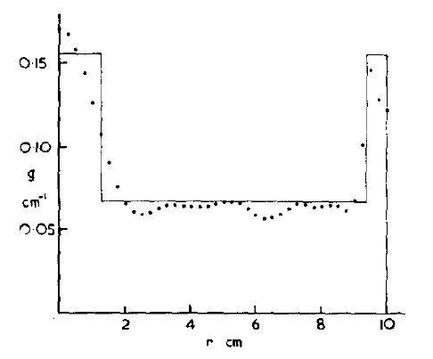
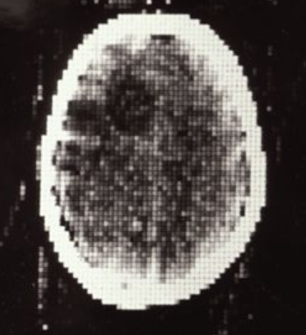
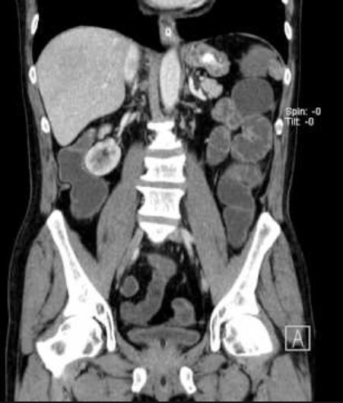
CT Yesterday and Today
Cormack – no images – cross-sections
Hounsfield/EMI – head only
Today: whole body, complete organ scanning
Thank you for the opportunity to review
my contributions to this transformation.

Slide 3
Affiliations & Developments
Purdue University
Elscint
GE Healthcare
  University of Washington, Seattle
Analogic
Csuptwo
  Tribogenics
  Samplify Systems
Technologies: aliasing, helical, variable pitch and moving beam helical, motion compensation, cardiac, breast CT, dual energy, helical multi-slice, automated threat recognition, volumetric display, metal artifact correction
Other: MRI, ultrasound, PET, nuclear med.

Slide 4
Collaborators
Kevin King
Albert Long
Asher Reuveni
Cam Ritchie
David Godwin
Norbert Pelc
Grant Gullberg
Chris Ruth
Greg Larson
Muzafer Hiraoglu
Steve Urchuk
Seemeen Karimi
Zhengrong Ying
Alan Wegener
Carlos Camara
Avi Kak
Ge Wang
Bill Lorenson
Harvey Cline
David Frazee
Tom Toth
Hui Hu
John Dobbs
Eric Bailey
Bernard Gordon
Sergey Simanovsky
David Rozas
Ibrahim Bechwati
Ram Naidu
Matt Hirsch
Basak Ulker Karbeyaz
Aldis Rauda
David Nahamoo
Jiang Hsieh
Michael Vannier
Ben Tsui
Robert Starshak
Bruce Teeter
Yongmin Kim
Chuck Stearns
David Schafer
Anton Deykoon

Slide 5
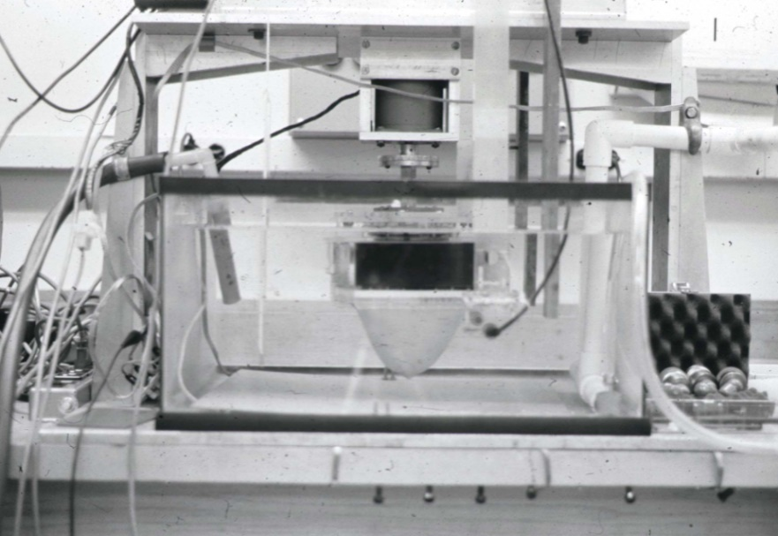
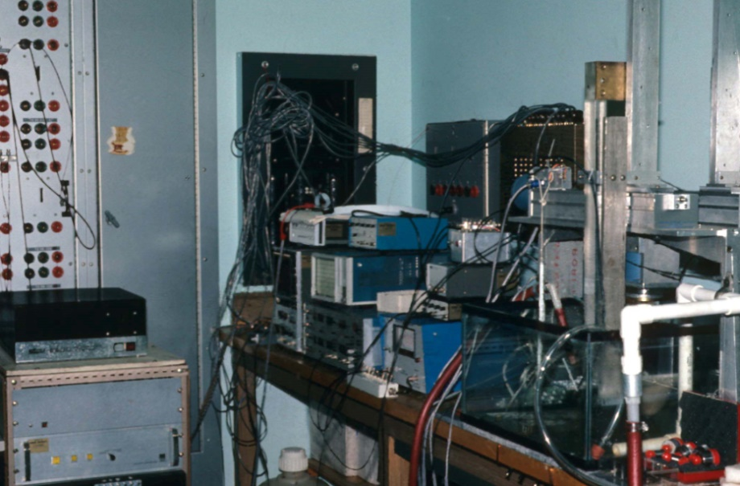
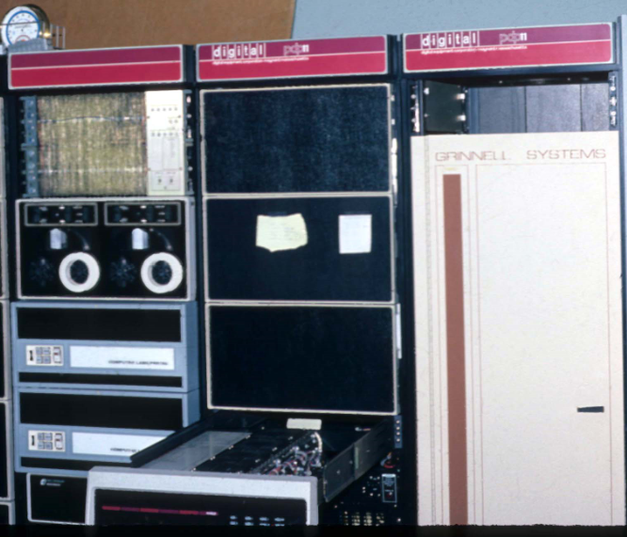
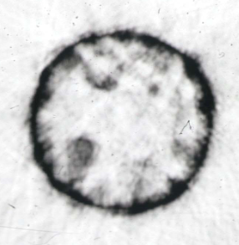
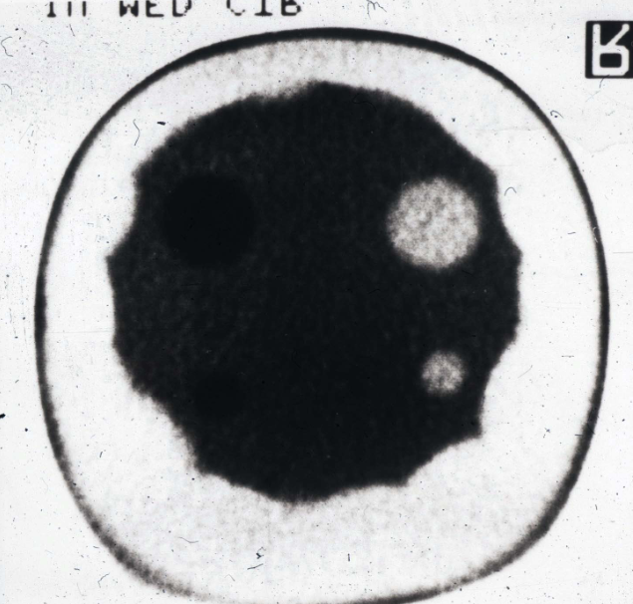
Breast CT (~1976)

Slide 6
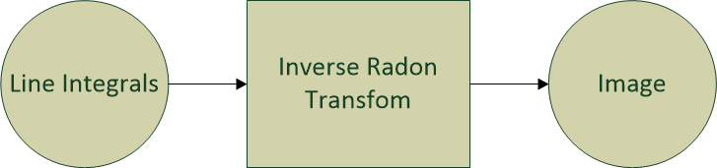
Cormack View of CT
Perfect line integrals of stationary object
Quantum noise
Finite resolution of detections

Slide 7


CT Advancements
Necessity is the mother of invention
Use scientific method to advance
Today – discuss personal contributions to field
  Best overview: Computed Tomography: Principles, Design, Artifacts, and Recent Advances, Third Edition, J. Hsieh
Simultaneous inventions
  Many inventors & contributors
History of helical CT in “Juice: The Creative Fuel That Drives World-Class Invention,” Evan Schwartz
  Kalendar and Crawford before RSNA
More that IQ (MTF, SNR, SSP, artifacts)
  Clinical efficacy
Deal with not having perfect line integrals
  Imperfect scanners and imperfect patients
  Purposely violate assumptions for helical

Slide 8
Image Quality
Resolution - spatial
  In plane (MTF)
  Cross plane – slice sensitivity profile (SSP)
Noise
  Signal to noise
  Low contrast resolution
Artifacts
  Streaks
  Rings
  Bands
  Textured noise
  Bone/soft tissue bleeding
  Low frequency shading
Clinical efficacy may be more than IQ!

Slide 9
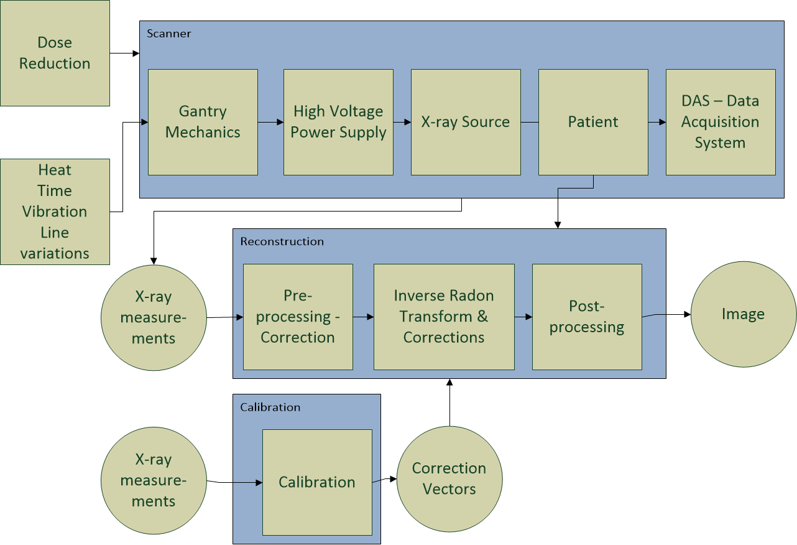

Slide 10
CT Improvements - Hardware
Slip ring gantries and stable mechanicals
Faster data collection
  Translate-rotate (first generation)
  Rotate-rotate (third generation, fan beam)
  Faster rotation speeds
  Helical/spiral
    Single slice
    Multiple slice
Higher power x-ray sources, power supplies, more heat storage
Lower noise and wider dynamic rate data acquisition
Smaller detectors and more projections

Slide 11
Imperfections (Subset)
Patient
  Motion: cardiac, respiratory, involuntary
  Z gradients
  Scatter
Mechanics
  Locations of focal spot, detectors
  Angle of projection
  Vibration
HVPS
  kV, mA drift & ripple
X-ray source
  Finite focal spot and movement
  Off-focal radiation
  Poly-chromatic spectrum
Collimation
  Penumbra
Detector
  Nonlinearities
  Crosstalk
  Afterglow
  Offsets
  Finite aperture
  Quenched flux
Data acquisition
  Nonlinearities
  Direct conversion
  Electronic noise
  Finite dynamic range
Sampling
  Aliasing
  Finite # detectors, projections
  Rotation during acquisition
Other
  Time drift
  Temperature variations
  Power line variations
  Dose reduction

Slide 12
Algorithmic Advancements
Helical reconstruction
Iterative reconstruction
  MBIR, ASIR
Motion compensation
Beam hardening correction
Temperature compensation
Crosstalk correction
Afterglow correction
Etc.
Enabled by faster computing

Slide 13
Helical CT
Scans completed in a breath hold
  Misregistration artifacts
GE scanners cable take up
  Limited number of scans
Obvious – continuous translation and rotation (first name!)
Knew about work at Varian, Toshiba (Mori), Illinois (Bressler)
Degraded SSP 100%.
Invention: two halfscans (180° + fan angle) in 360° scan; helical extrapolative.

Slide 14
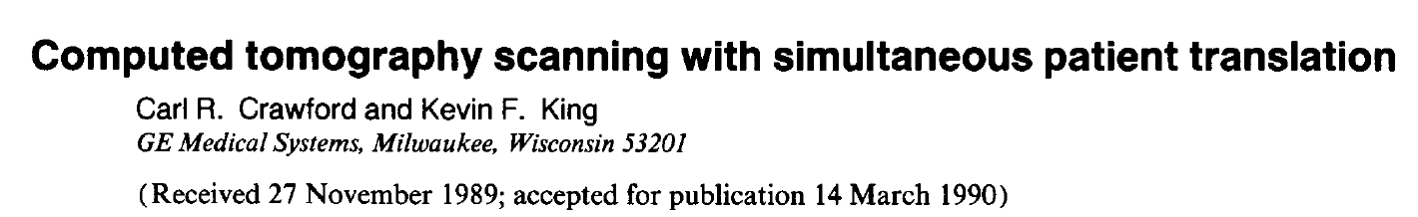
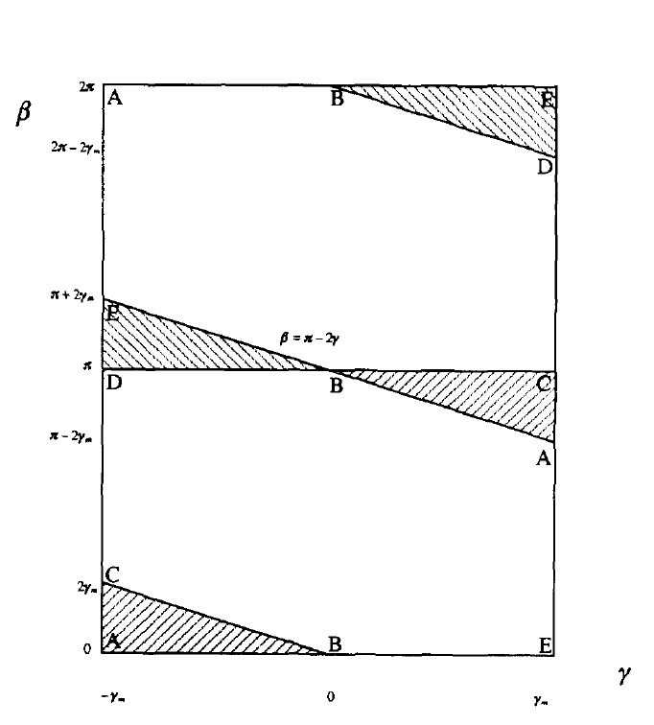
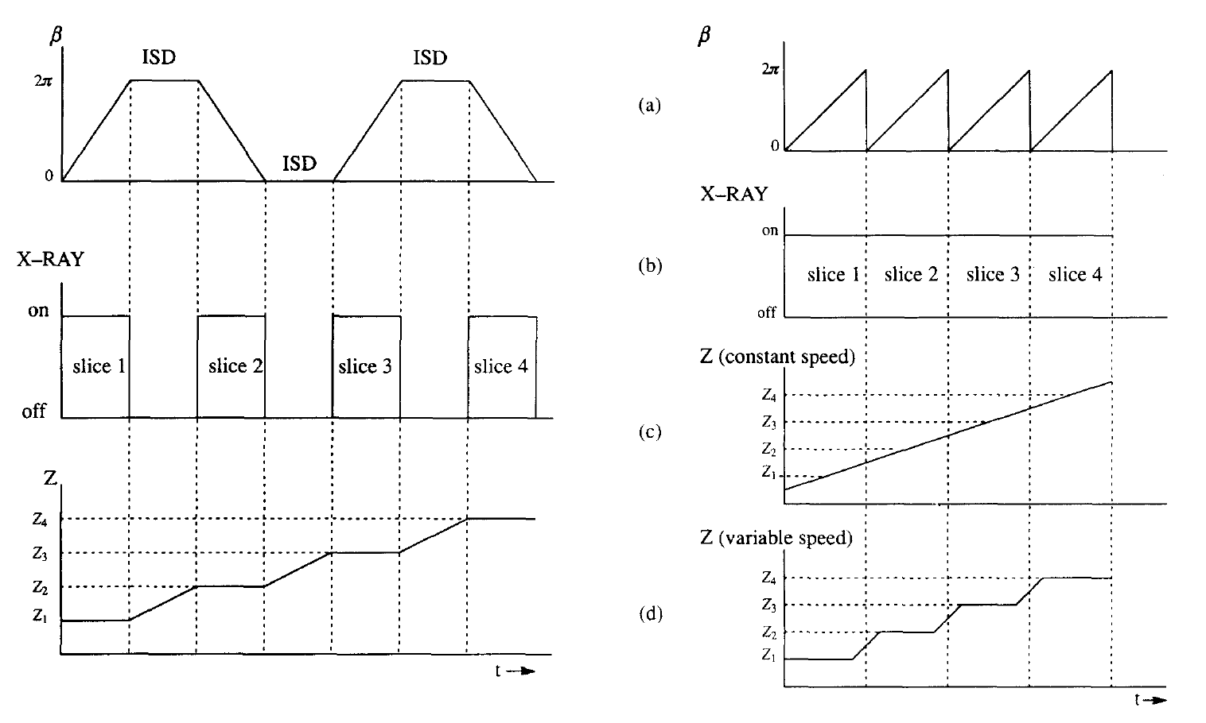

Slide 15
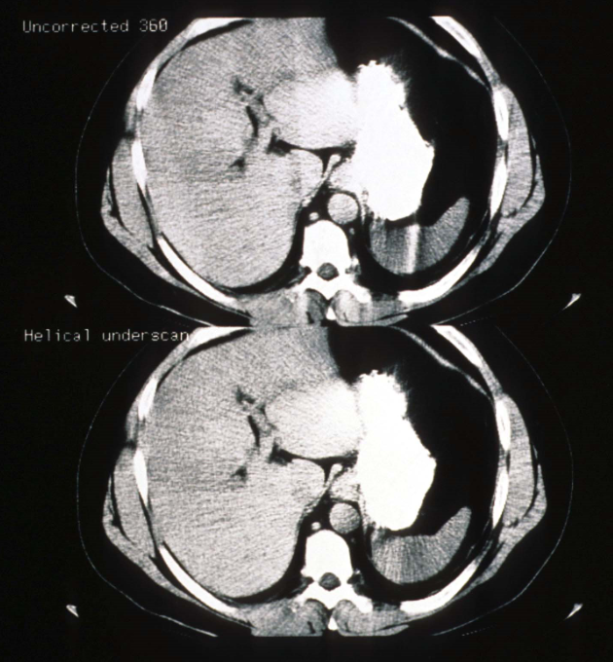
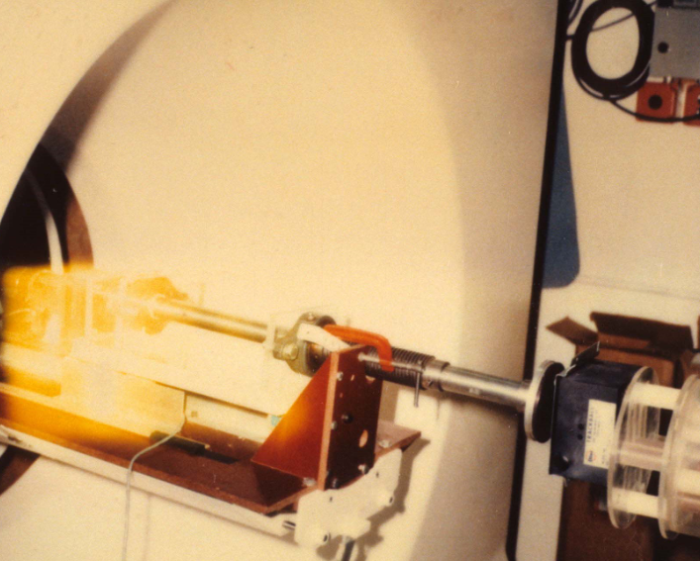
Helical Initial Results

Slide 16
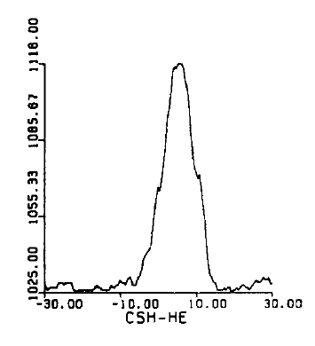
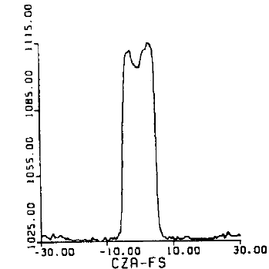
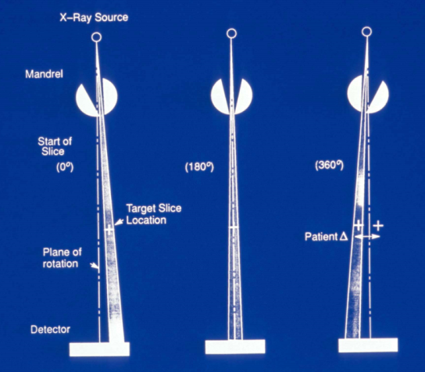
SSP Concerns
Slice no longer a slab
Investigated moving beam helical scanning
Missed that helical with degraded IQ enabled new clinical imaging
  CT angiography, whole organ, screening

Slide 17
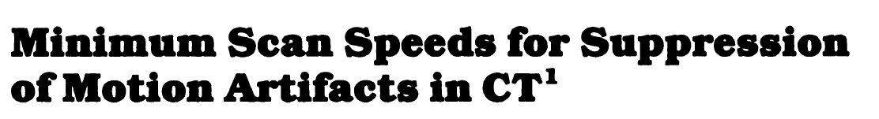

Minimum Scan Speeds
Predicted 19.1 msec scans for cardiac
  Confirmed by others
Looking at methods to compensate motion
Started with Glover/MRI

Slide 18
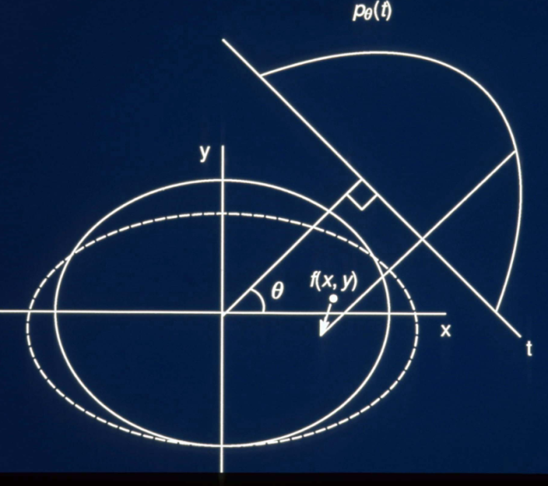
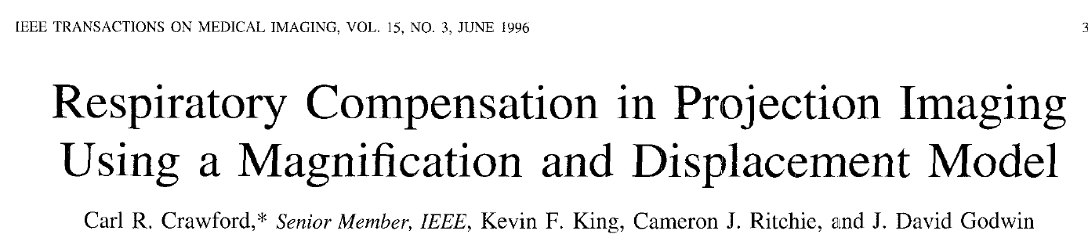
Magnification Model
Math leads back-project where pixel was at time of data collection
Assumption not valid
Assume that was valid
  Got good results
  Later substantiated by others

Slide 19
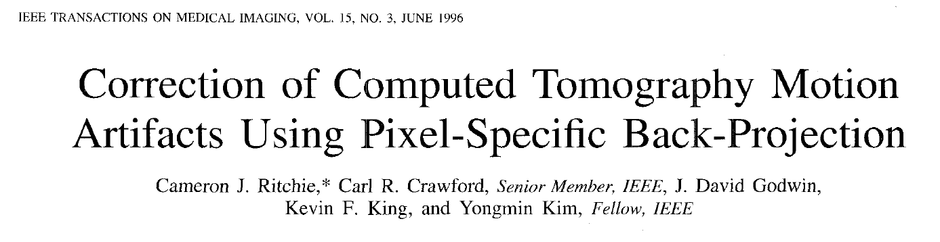
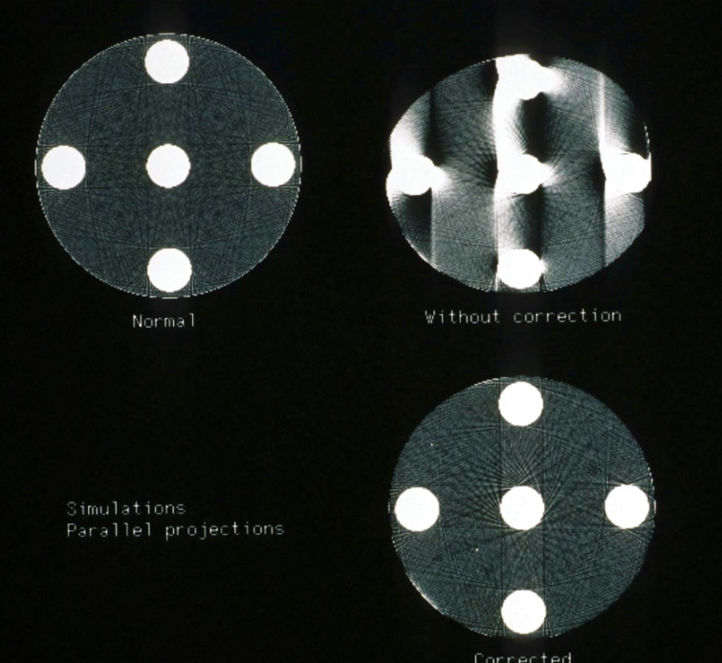
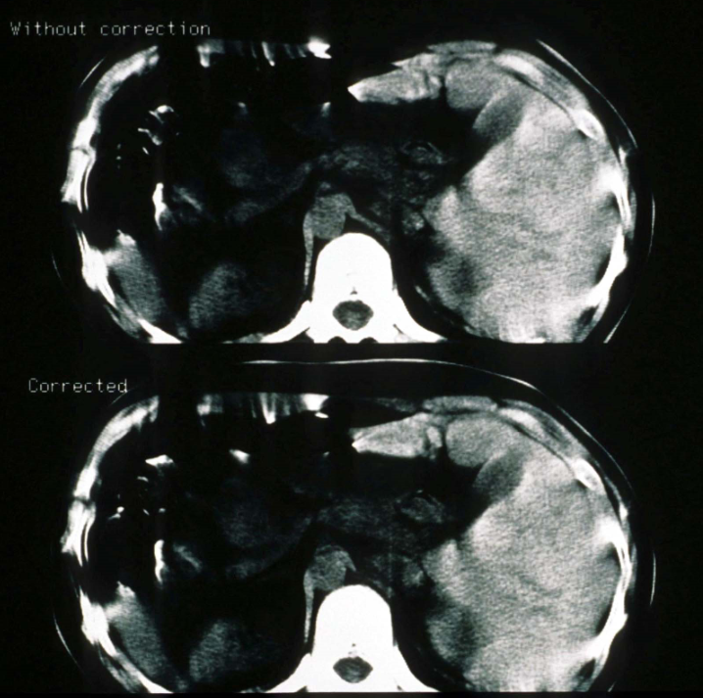
Pixel Specific Back Projection

Slide 20
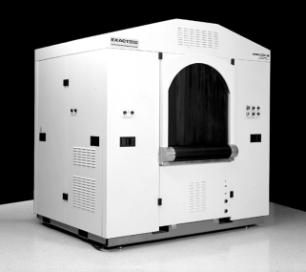
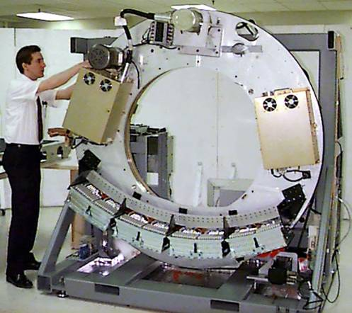
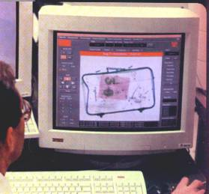
Checked Baggage CT
EXACT AN 6000
X-ray tube
Gantry
X-ray tube
Breaks bag into numerous voxels
EDS System
Detector
Array
BAG
Detector Array
X-ray Measurements are Processed to Provide Total Image of Bag for Threat Analysis
Bag Viewing Station
Bag Image is Presented to Operator Using Baggage Viewing Station for Final Assessment
Detection Algorithm
Analysis of 100% of Bag is Performed on CT Image

Slide 21
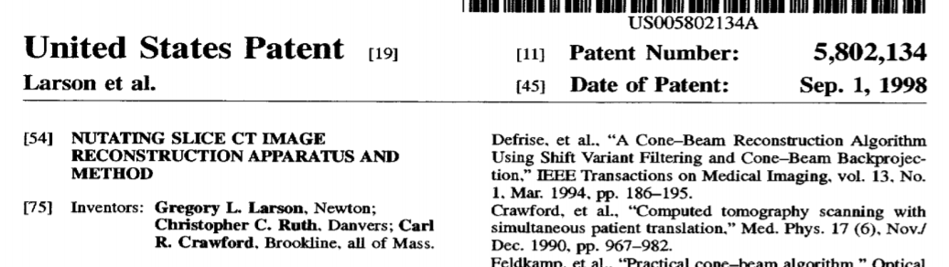
Nutating Slice Reconstruction
NSR used is Analogic/L3 scanner circa 1996

Slide 22
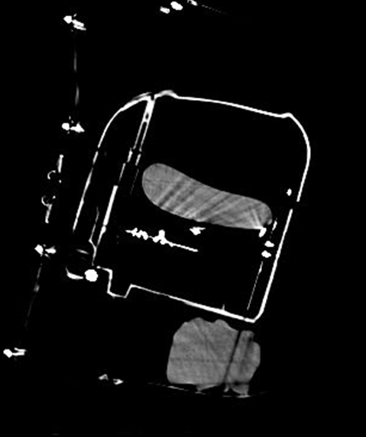
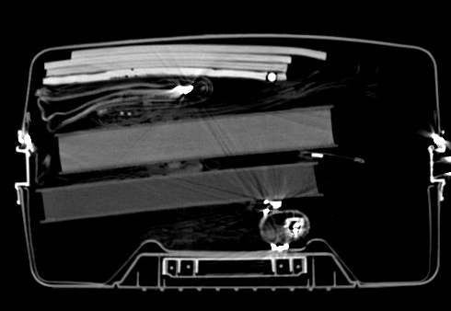
Sample CT Images
Reconstructed with 2D parallel back-projection

Slide 23
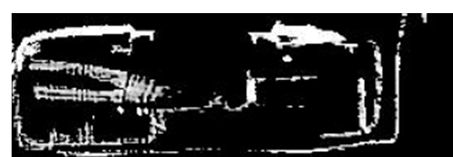
Dual Energy Reconstruction
Operator
Display
Dual energy
Decomposition
FBP
FBP
Explosive
Detection
Alvarez/Macovski did not work – metal, noise, spectral drift.
Other steps used to compensate for these issues.

Slide 24
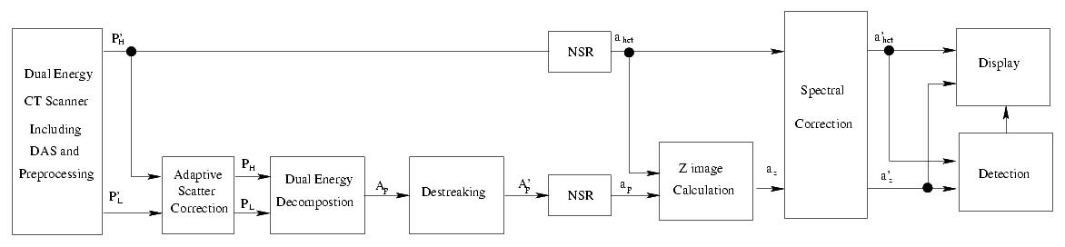

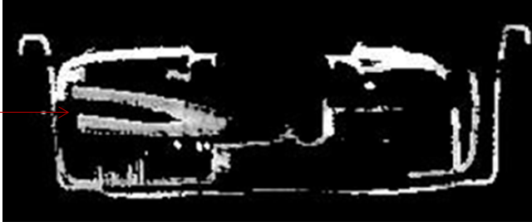
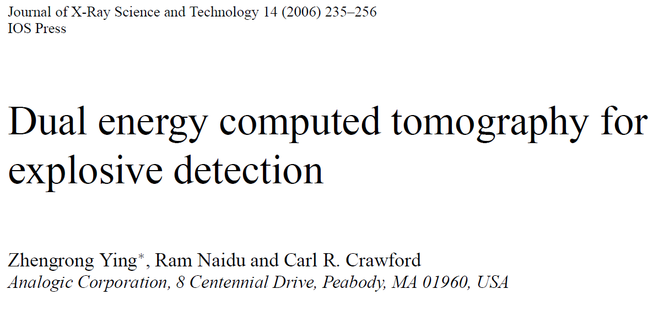
Duel Energy Algorithm

Slide 25
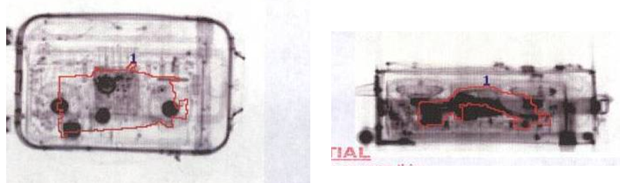
Automatic Threat Detection
Multi-Path
Segmentation
Feature
Extraction
CT
Correction
Discrimination
Sheet Filter – Sheet Path
Bulk Filter – Bulk Path
Object Segmentation
Other features
Mass
Density
Z-effective
Other Features
Orientation
Other Scanner Specific
Corrections
Non-linear
thresholds
For both
Density and
Z-effective

Slide 26
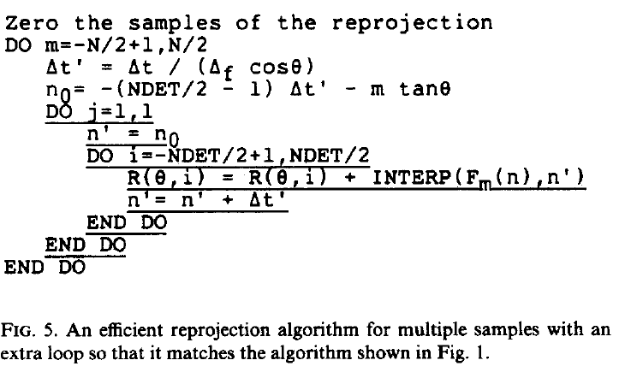
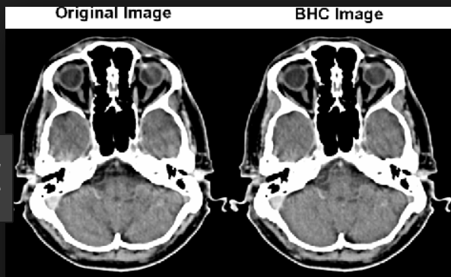
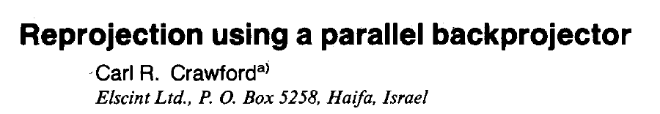
Iterative Bone Correction
Need fast re-projection
Rows/columns fed into hardware back-projector = parallel projections
  Firmware change required

Slide 27
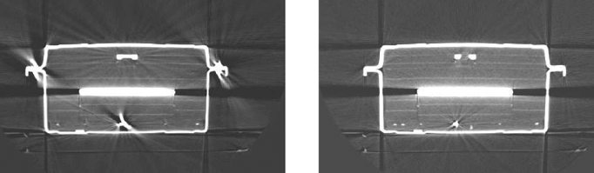
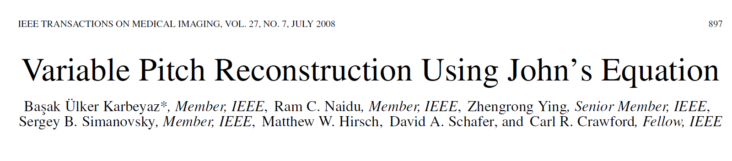
Variable Pitch Helical
Nutating slice lead to artifacts with variable speed.
Use John’s equation to create required cone beam projections
  Based on Defrise, Noo & Kudo

Slide 28
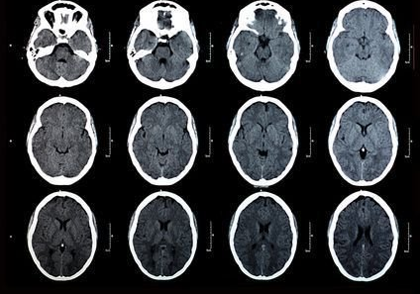
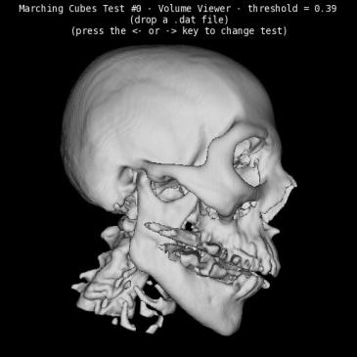
Medical Imaging Example
GE told me to lead project to develop 3D images of skulls
Did not have the technical expertise, which was okay with GE

Slide 29

A Man from Milwaukee
”Creative Energy: GE's Latest Invention – A Way to Move Ideas From Lab to Market,” Wall Street Journal, June, 1990.
Four years ago, metallurgist Harvey Cline was developing a method of measuring the surface topography of silicon chips, which would show the wafers' defects. The technique essentially involved measuring three dimensions of hair-thin surfaces. Then one day, GE's medical division sent a man from Milwaukee to talk at the R&D center about the need for three-dimensional imaging for medical purposes.

Slide 30
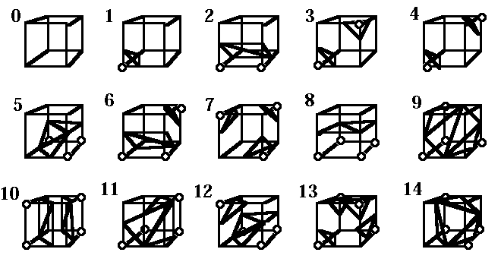
A Man From Milwaukee (2)
Lorensen & Cline invent marching and dividing cubes (and become famous)
GE Medical deploys first high-speed 3D display package for medical imaging
CBP: Don’t Be Afraid to Ask For Help

Slide 31
Additional Information
Computed Tomography: Principles, Design, Artifacts, and Recent Advances, Third Edition, J. Hsieh, SPIE.
www.csuptwo.com/patents.html
www.csuptwo.com/journals.html

